Slide 1

Project Title - Seasonal Agriculture Performance Analysis
Name: Om Dayanand Nayak
College Name: Keraleeya Samajam's Model College (Autonomous)
AICTE STU ID : STU6a6614587cdf21785074776

Slide 2

PROBLEM STATEMENT
Agricultural activities are influenced by seasonal variations in environmental conditions, farming practices, resource availability and market conditions. As a result, agricultural performance may differ from one season to another.
However, raw agricultural data does not clearly explain how agricultural performance changes across seasons or what patterns can be observed in different seasonal conditions.
The problem is to analyze the given agricultural dataset and investigate seasonal differences in agricultural performance by identifying meaningful patterns, trends, relationships and variations within the available data.

Slide 3
Project Description
Seasonal Agriculture Performance Analysis is a Data Analytics project focused on understanding how agricultural performance changes across different seasons, regions, farming conditions, and resource usage.
The project involves exploring, cleaning, and analyzing agricultural data to identify meaningful seasonal patterns, trends, relationships, and variations. Key factors such as crop production, environmental conditions, resource utilization, and economic outcomes are examined to compare agricultural performance across different seasons.
Using Python, Pandas, statistical analysis, and data visualization techniques, the project aims to transform raw agricultural data into meaningful insights. The findings can help identify significant seasonal differences, unusual patterns, and relationships between environmental conditions and agricultural outcomes.
The final analysis provides evidence-based insights and recommendations that can support better understanding and planning of seasonal agricultural activities.

Slide 4

WHO ARE THE END USERS?
Farmers
Agricultural Planners
Government Agriculture Departments
Agricultural Researchers
Agribusinesses & FPOs
Agricultural Consultants

Slide 5

Technology Used
  Python
  Google Colab
  Pandas
  Exploratory Data Analysis
  Matplotlib
  Seaborn
  Statistics
  Data Cleaning
  Statistical Analysis
  Data visualization

Slide 6
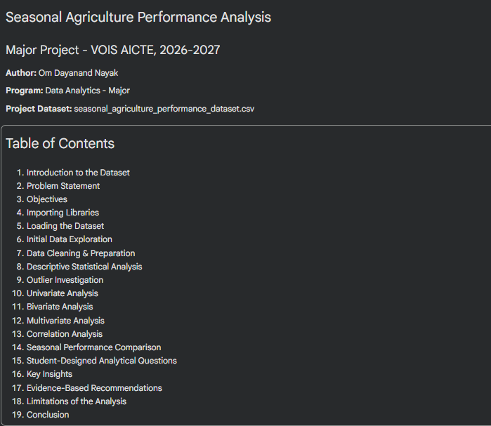
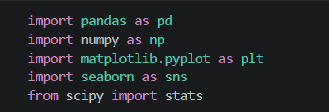
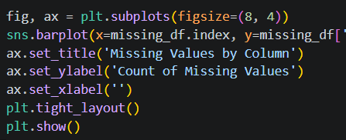
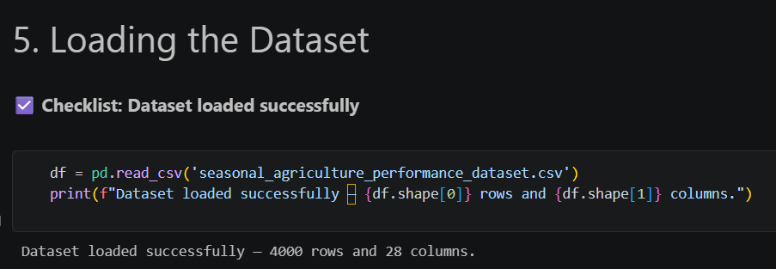
RESULTS

Slide 7
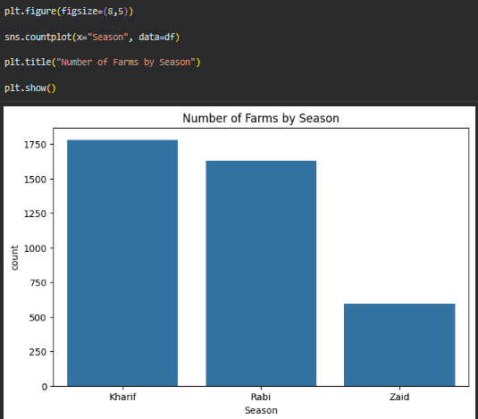
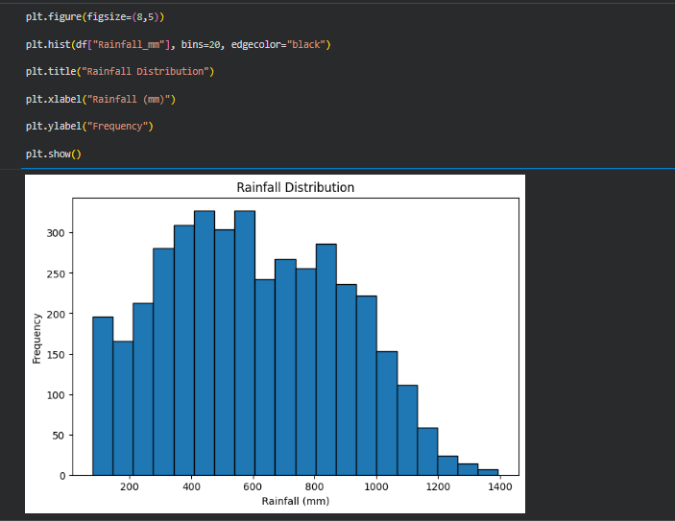
RESULTS
[Add screen shots of your code ]

Slide 8
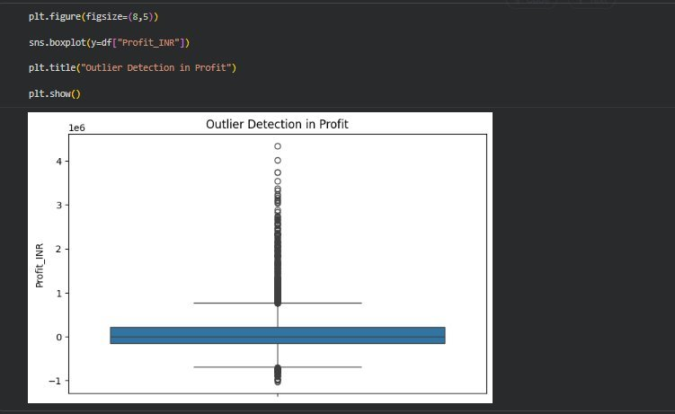
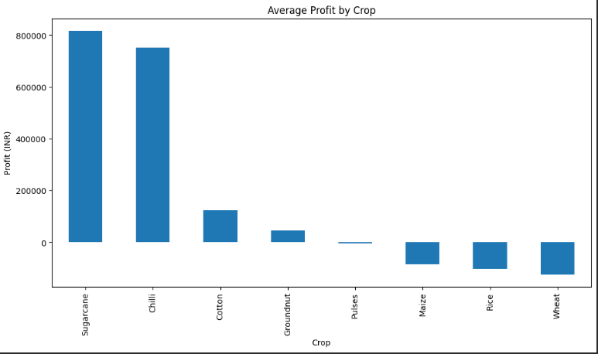
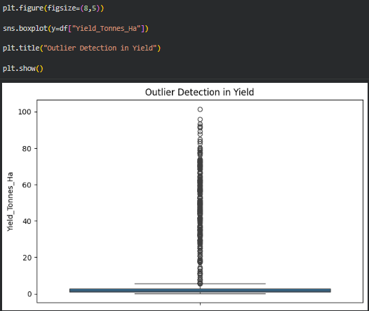
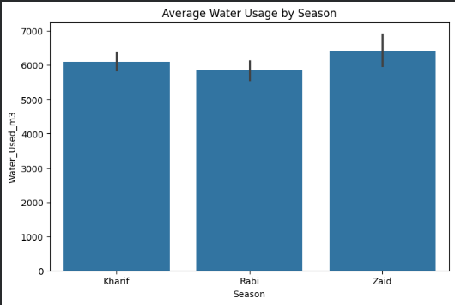
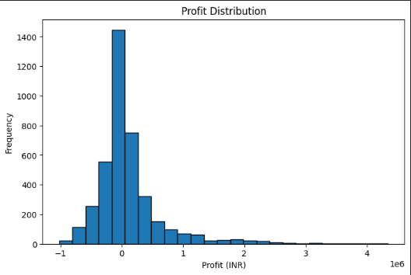
RESULTS

Slide 9
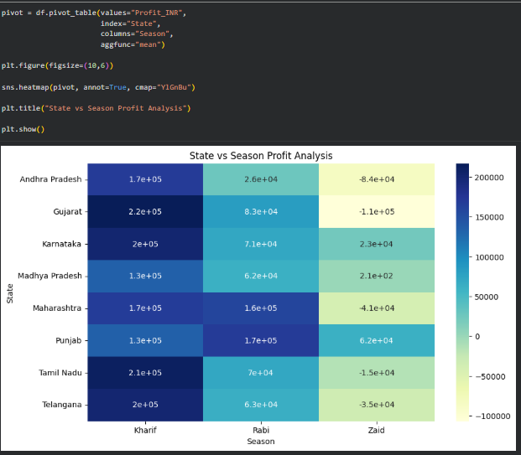
RESULTS
[Add screen shots of your code ]

Slide 10
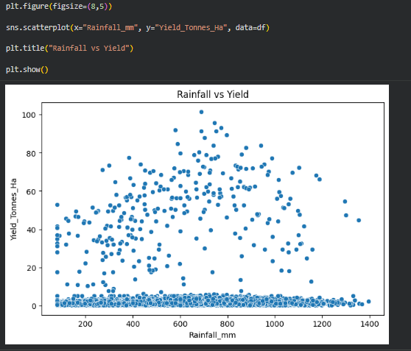
RESULTS
[Add screen shots of your code ]

Slide 11
Future scope
Real-time agricultural data monitoring
Crop yield prediction
AI-based seasonal crop recommendations
Weather and climate-based analysis
Regional-level agricultural forecasting
Smart resource allocation
Market price and demand prediction
Integration with IoT and sensor data
Mobile/Web-based agricultural dashboard
Advanced Machine Learning models for prediction

Slide 12
GitHub Link
https://github.com/Study000234/Seasonal-_Agriculture_Performance_Analysis_VOIS.git

Slide 13

VOIS Course completion certificate -
Course name- Data Visualization

Slide 14
Thank you
.

